Slide 1
Health Knowledge Management for Clinical Decision Support Services:
Art of the Possible
Raza Abidi
Professor of Computer Science
Director of Health Informatics
Faculty of Computer Science
Dalhousie University
Halifax, Canada
sraza@cs.dal.ca
www.cs.dal.ca/~sraza

Slide 2
Agenda
Healthcare Knowledge Management
  From Health Data to Healthcare Knowledge
Healthcare Services
  Clinical Decision Support as a Service
Healthcare Knowledge Modeling
  Towards a Healthcare Enterprise

Slide 3
Preamble
trying harder to make the existing system work better will not be enough
(Institute of Medicine)
Institute of Medicine. To Err is Human: Building a Safer Health System. Washington, DC: National Academy Press; 2000.

Slide 4
Healthcare IT …. State of Practice
Data- and information driven
  Health Databases
  Healthcare Information Management Systems
  Healthcare knowledge?
Support for individual healthcare tasks
  Process level data capture and use
  Healthcare services?
Islands of automation
  Self contained (localized) Information Infra-structures
  Healthcare enterprise?
Re-active
  Patient activates the process …. Healthcare team responds
  Healthcare (proactive and personalized) planning?
Quasi-deterministic action paths
  Built on localized information flows and clinical practices
  Healthcare standardization?

Slide 5
From Health Data to Healthcare Knowledge
Practitioner’s Knowledge
Healthcare Knowledge Management
Best Evidence
Policies
Standards
Processes
Electronic Health Records
Clinical Decision Support
Patient Management
Clinical Pathways Optimization
Laboratory
Orders Management (CPOE)
Information
Pharmacy
HEALTH KNOWLEDGE MANAGEMENT SYSTEM
Picture
Archiving
& Comm.
System
(PACS)
HEALTH INFORMATION MANAGEMENT SYSTEM
HEALTH KNOWLEDGE MANAGEMENT SYSTEM
Data
HEALTH INFORMATION MANAGEMENT SYSTEM
Knowledge Generation & Translation
Patient Care Planning
Data
Health Promotion
Outcome Measurement
Radiology
Best Evidence (Info-Buttons)
Patient Registration
Resource Scheduling
Patient Empowerment
Physician
Data
Finance
Administration
Inventory

Slide 6
Healthcare Knowledge Management
“Healthcare Knowledge Management can be characterized as the systematic creation, modeling, sharing, operationalization and translation of healthcare knowledge to improve the quality of patient care”
(Abidi, 2008)
SSR ABIDI. Healthcare Knowledge Management: The Art of the Possible.
In David Riano (Eds) K4CARE, Lecture Notes in Artificial Intelligence LNAI 4924, Springer, 2008, pp. 1-21.

Slide 7

Safe, Quality, Cost-Effective, Pro-active and Planned Patient Care
Healthcare Enterprise
Delivery
Care Management & Planning
Clinical Decision Support
Care Standardization & Audit
Risk Assessment
Info-Buttons
Patient Empowerment
Evaluation
Workflow Integration
Healthcare Services
Operationalization
Clinical Practice Guidelines
Clinical Pathways/Protocols
Evaluation Tools
Practitioner’s Know How
Nursing Care Plans
Social Networks
Medical Literature
Computerization
Modeling
Healthcare Knowledge
Healthcare Data

Slide 8
Healthcare Knowledge Centric Services
HKM Service Types
Transformational Services
Knowledge Translation
Technology-Enabled Knowledge Translation
Automated Outcome Analysis
Policy Development
Public Health
Public Health Surveillance
Public Health Interventions
Patient Care Services
Personalized Patient Education & Empowerment
Patient Monitoring
Risk Assessment
Patient Management
Clinical Decision Support
Patient Care Planning
Patient Safety Alerts & Reminders
Healthcare Knowledge-Centric Services
Knowledge Sharing
Knowledge Sharing (Community of Practice)
Social Networking Analysis
Care Team Collaboration
Knowledge Access
Info-Buttons
Best Evidence Retrieval
Knowledge Annotation & Indexing
Enabling Services
Bio-medical Terminologies
Healthcare Knowledge Indexing & Storage
Semantic Interoperability
Knowledge Creation
Computerizing Healthcare Knowledge (CPG, Clinical Pathways, Care Plans)
Healthcare Text Analysis (Mining)
Healthcare Knowledge Procurement
Healthcare Knowledge Modeling & Representation

Slide 9
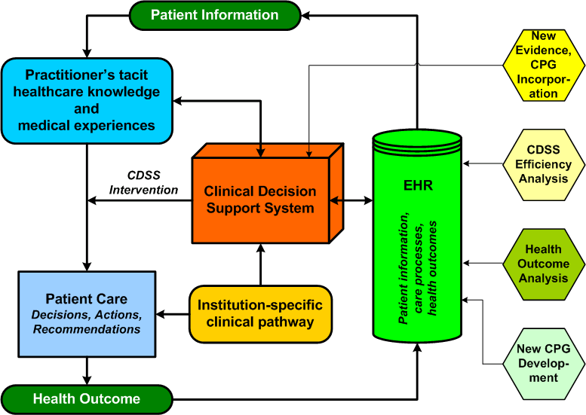
FOCUS: Clinical Decision Support Services

Slide 10

Clinical Decision Support Lifecycle
  Interpretation of domain concepts
  Identification of Processes, Actions, Decisions, Recommendations, Constraints, etc.
  Specification of decision making algorithm
  Clinical Pragmatics
Procurement
Decision Support Services
Evaluation
Modeling
Workflow Integration
Healthcare Knowledge
Healthcare KM
Codification
  Point-of-care access
  Integration with infra-structure
Operationalization
Storage
  Decision Model
    Arden syntax
    Ontology
    Logical rules
  System Execution
  Input: Patient data
  Output: Patient-specific knowledge
Inferencing/Reasoning
  Knowledge base
  Reasoning engines
  Selection and manipulation of knowledge

Slide 11
Towards CDSS
Text-based
CPG
Institutional
considerations
Localized CPG
CPG representation formalism &
CPG encoding strategy
Computerized
CPG
Clinical workflow, pragmatics
& reasoning strategy
Clinical Decision
Support System
Patient Data
CPG-based, Patient-Specific
Recommendations

Slide 12
Healthcare Knowledge Modeling
Introduction Section
Section B
Plan X
Process P
Tasks
Action
Action
Recommend-
ation A
Action
Action
True
CPG
Sync
Decision
Recommend-
ation B
True
Action
Data
False
Decision
False
Recommend-
ation C
Process R
Plan Y
Section C

Slide 13
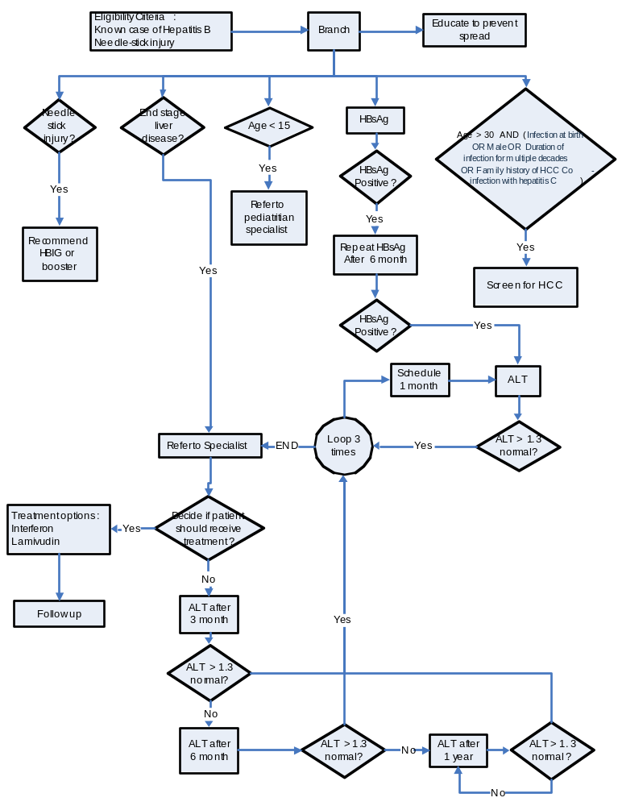
Knowledge Model
Clinical Management of Chronic Hepatitis B

Slide 14
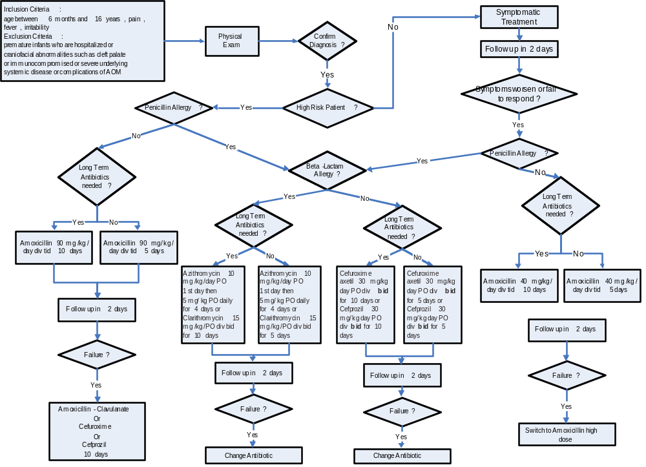
Diagnosis and Treatment of Acute Otitis Media (AOM) in Children

Slide 15
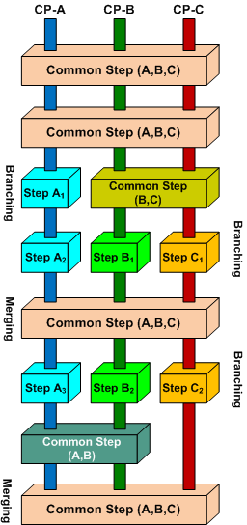
Computerization of Clinical Pathways (CP)
Knowledge Modeling
  Modeling CP knowledge as an ontological model
  ‘Unified’ model of the CP
    Turning localized CP to a generic model
  Modeling the ‘branching’ and ‘merging’ points to align multiple CP
    Common processes, actions and recommendations
Knowledge Execution
  Execution of prostate cancer CP using a logic-based reasoning engine

Slide 16
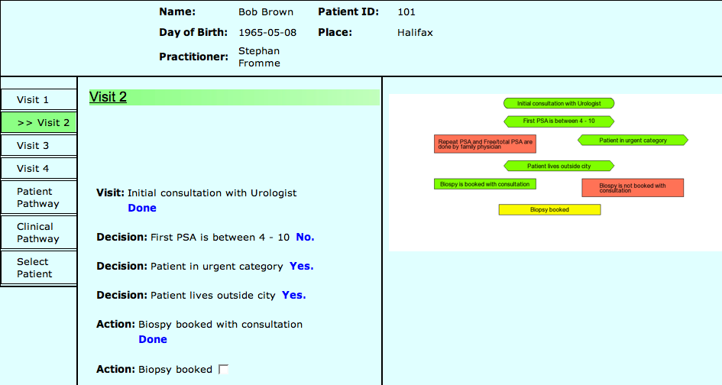
Prostate Cancer Management System

Slide 17
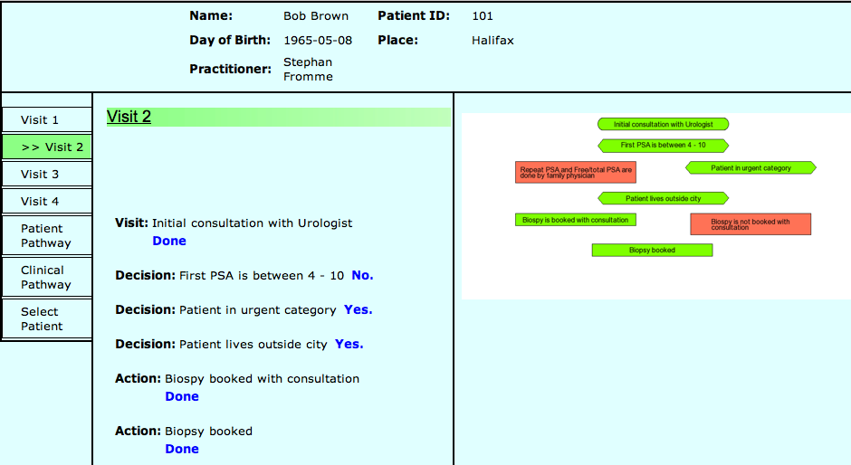
Prostate Cancer Management System

Slide 18
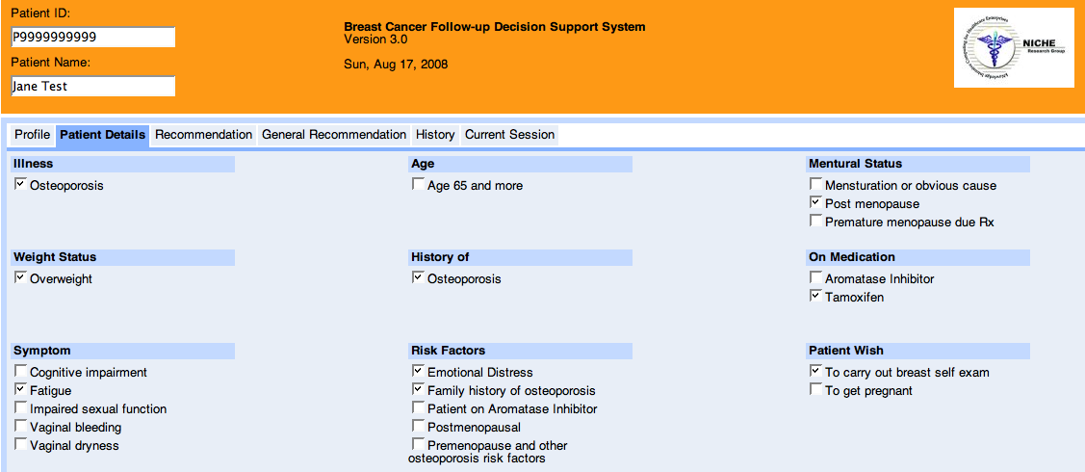
SYSTEM DEMO
CPG Based Decision Support System

Slide 19
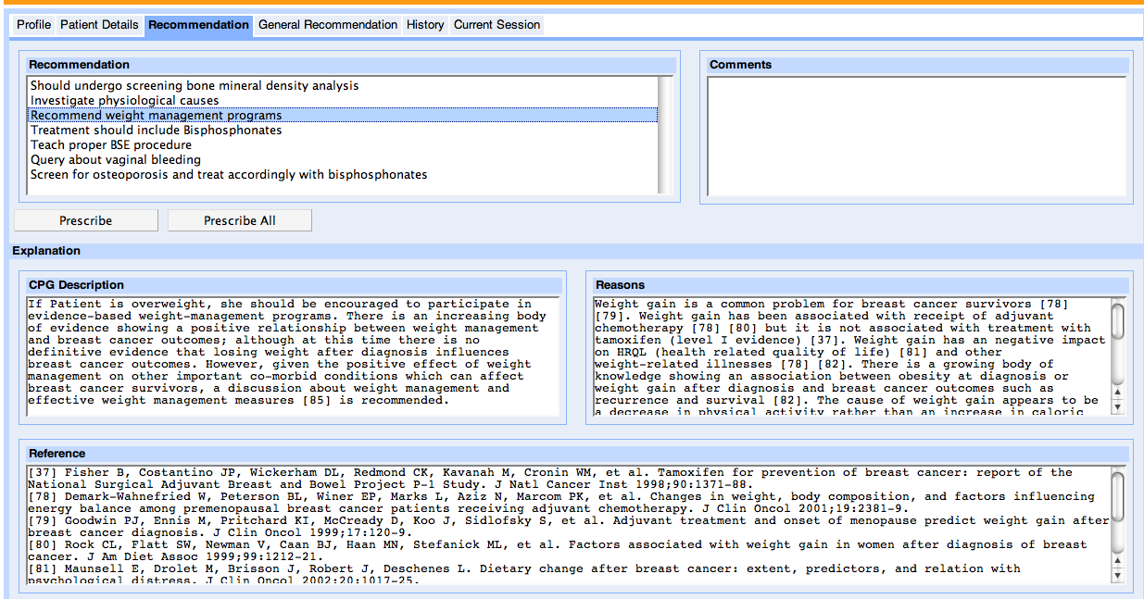
SYSTEM DEMO
CPG Driven Decision Support System

Slide 20
THANK YOU
Raza Abidi
sraza@cs.dal.ca
www.cs.dal.ca/~sraza
@
NICHE Research Group
(kNowledge Intensive Computing for Healthcare Enterprises)
www.cs.dal.ca/~niche

